Slide 1
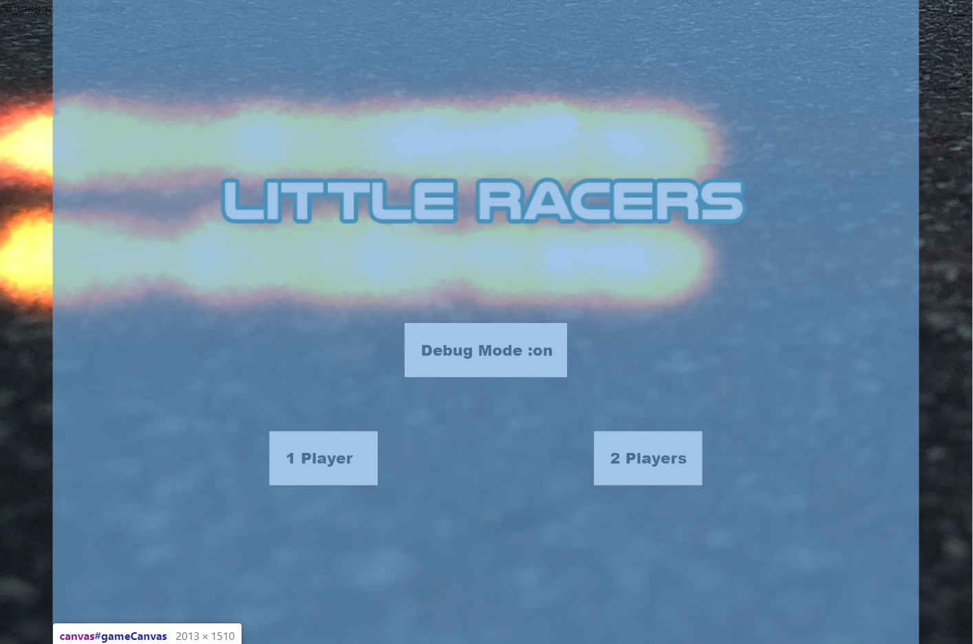
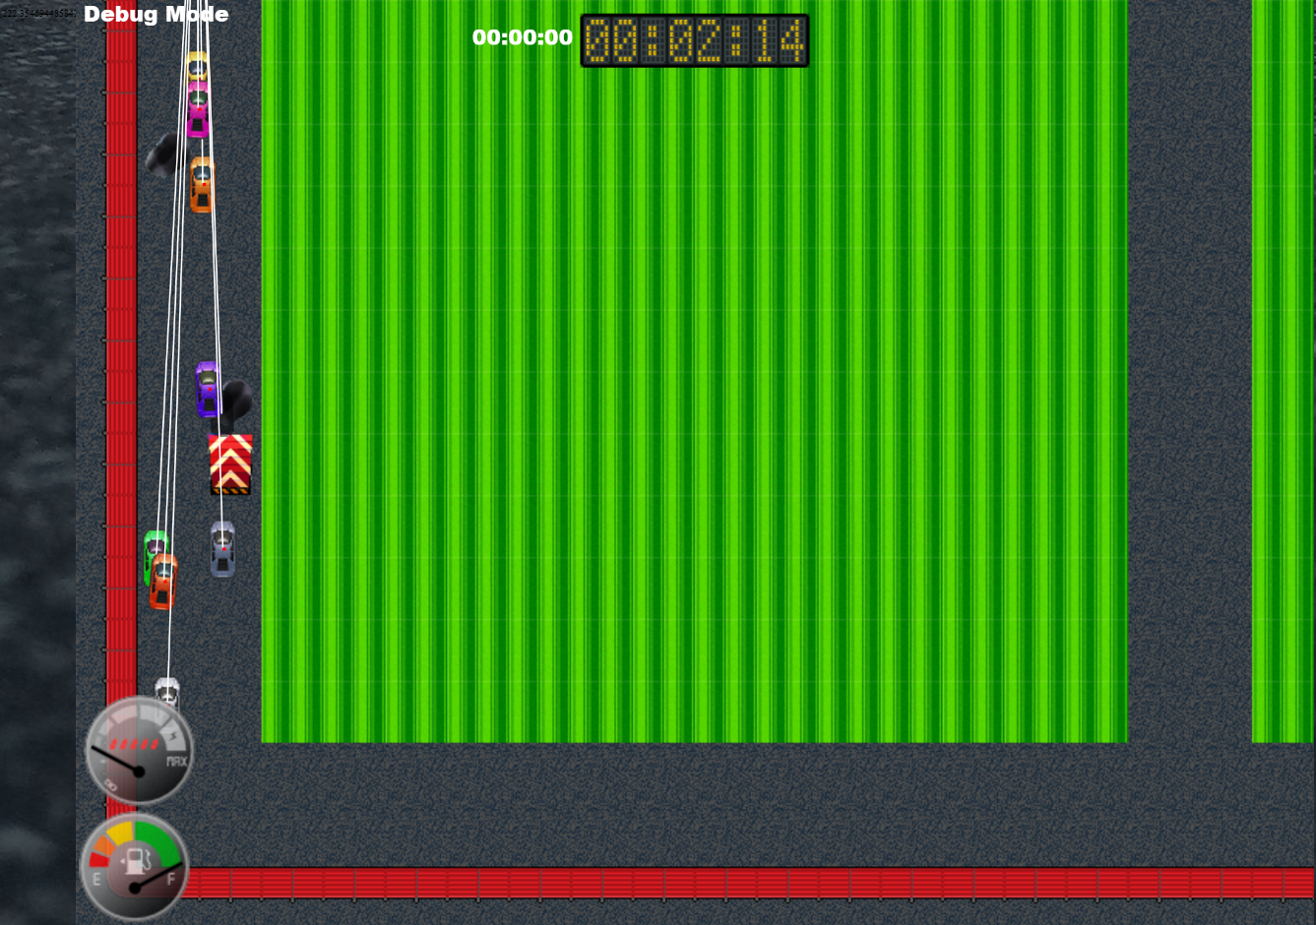
Little Racers
Pitch Date: June 22 , 2019 Week 5: 7/27/2019
Release Date: September 15, 2019 7 weeks to go!
Team Lead: Vince McKeown
17 contributors

Slide 2
Updates to Code
Mike LeSauvage
Added corner arena boundary walls
Comments to explain shields and health
Consolidated a bunch of code
Implemented clock font, made corrections to upgrade screen
Fixed a lot of things!
Simon
Oil causes car to slip
Fixed damaged particle merge

Slide 3
Updates to Code
Baris Koklu
AI for car braking on turns
Christer “McFunky Pants” Kaitila
Fire Effects enabled in title screen
Anthony Free
Car catches on fire!
H Trayford
Title Screen loop for Fire Animation
Changed SmokeFX parameters
Varying AI code for waypoint and slow down modified

Slide 4
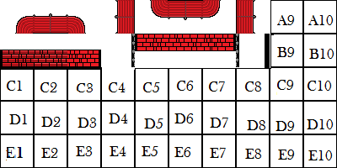

Updates to Art
Jeff Hanlon
Mike LeSauvage

Slide 5
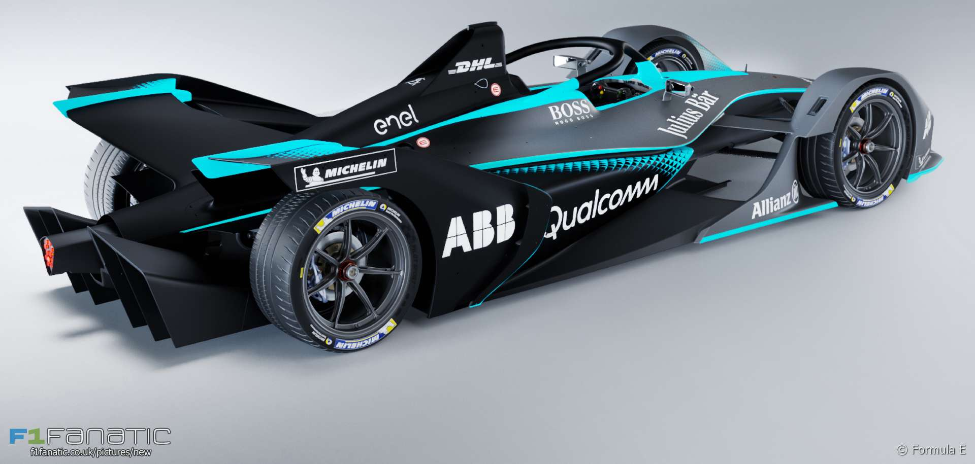
Demo
Cutover to Game

